Slide 1
DIABATES PREDICTION
(DATA SPLITTING AND MODEL BUILDING)
SRUTHI.S
2019506098

Slide 2

SPLITTING THE DATASET
Train Dataset: Used to fit the machine learning model.
Test Dataset: Used to evaluate the fit machine learning model.
The objective is to estimate the performance of the machine learning model on new data: data not used to train the model.
The scikit-learn Python machine learning library provides an implementation of the train-test split evaluation procedure via the train_test_split() function.
Common split percentages include:
Train: 80%, Test: 20%
Train: 70%, Test: 30%

Slide 3
LOGISTIC REGRESSION
It is basically a supervised classification algorithm to find the probability of dependent variable.
Logistic regression is usually used for Binary classification problems. Binary Classification refers to predicting the output variable that is discrete in two classes.
a classification problem, the target variable(or output), y, can take only discrete values for given set of features(or inputs), X.
Types : Simple Logistic Regression, Multiple logistic regression

Slide 4
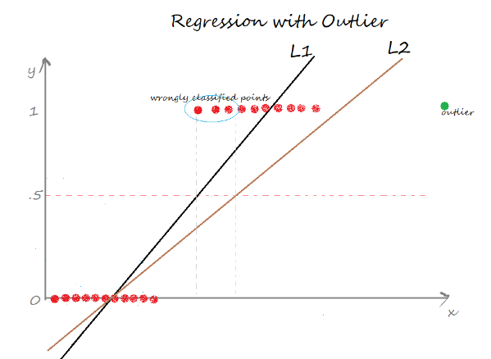
WHY NOT LINEAR REGRESSION FOR CLASSIFICATION PROBLEM?

Slide 5
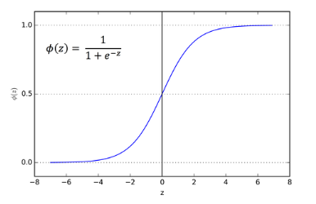
How does Logistic Regression Works?
It uses sigmoid function. It is useful to map any predicted values of probabilities into another value between 0 and 1.
A linear equation (z) is given to a sigmoidal activation function (σ) to predict the output.
It is an S-shaped curve that can take any real-valued number and map it into a value between 0 and 1
In logistic regression, the output is always a probability value between 0 or 1.

Slide 6

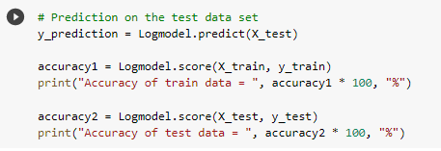

Implementation
Here we use scikit-learn library for implementing logistic regression.
First we have to create Logistic Regression classification object.
Next we have to fit the model with training data
Then we have to predict the model on test data.
Accuracy is calculated.

Slide 7

SUPPORT VECTOR MACHINE
It is one of the supervised machine learning algorithm.
Hyper-plane is a decision boundary which is constructed such that the distance between data points closest to hyper-plane in each class is maximum.
Support vectors: SVM algorithm finds the closest point of lines from both the classes. These points are called support vector and they pass through the marginal plane.
The hyper-plane with maximum margin is called optimal hyper-plane.
The main goal of SVM is to maximize the margin.

Slide 8
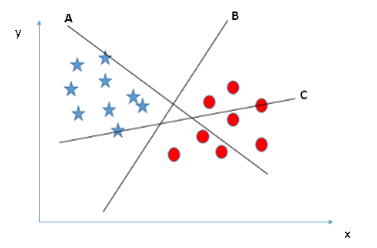
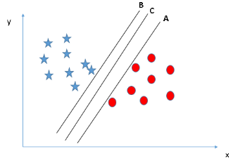
HOW SVM WORKS?
Choose the optimal hyper plane.

Slide 9
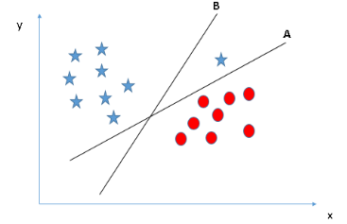
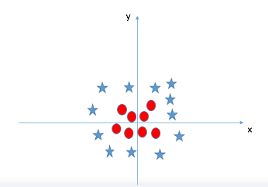

Slide 10

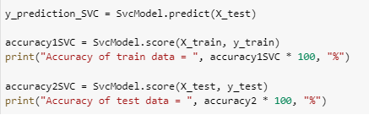
Implementation
Here we use scikit-learn library for implementing SVM.
First we have to create SVM classification object.
Next we have to fit the model with training data
Then we have to predict the model on test data.
Accuracy is calculated.

Slide 11
HYPER – PARAMETER TUNING
Hyper parameter tuning is choosing a set of optimal hyper parameter for learning algorithm.
Hyper parameters cannot be learned directly from the training process.
It is a model argument whose value is set before learning process begins.
It controls over-fitting and under-fitting of the model. Optimal hyper parameters often differ according to the dataset.
Not all model hyper parameters are equally important. It is desirable to select a minimum subset of model hyper parameters to search because more hyper parameters of an algorithm that you need to tune, slower the training process.
Different models have many hyper parameters, for finding the best combination of parameters, we have 2 methods namely:
GridSearchCV
RandomizedSearchCV

Slide 12
GridSearchCV & RandomizedSearchCV
In GridSearchCV approach, machine learning model is evaluated for a range of hyper parameter values. This approach is called GridSearchCV, because it searches for best set of hyper parameters from a grid of hyper parameters values.
Drawback : GridSearchCV will go through all the intermediate combinations of hyper parameters which makes grid search computationally very expensive.
RandomizedSearchCV solves the drawbacks of GridSearchCV, as it goes through only a fixed number of hyper parameter settings. It moves within the grid in random fashion to find the best set hyper parameters. This approach reduces unnecessary computation.

